Slide 1
The Names of GOD to Jesus
EXODUS 3:13-15

Slide 2
The power in the name…
Character
Identity

Slide 3
The people prayed to the God ….
Abraham, Isaac and Jacob (Exode 3:15)

Slide 4
Moses' encounter with God…
God revealed his name to Moses for the first time
Exodus 3:14

Slide 5
What is the meaning …
“I am who I am”
“I will be what I will be”

Slide 6
Meaning…
I am Everlasting (Mal3:6; Isaiah 42:8)
He does not change. (Heb 13:8; Rev1:8)

Slide 7
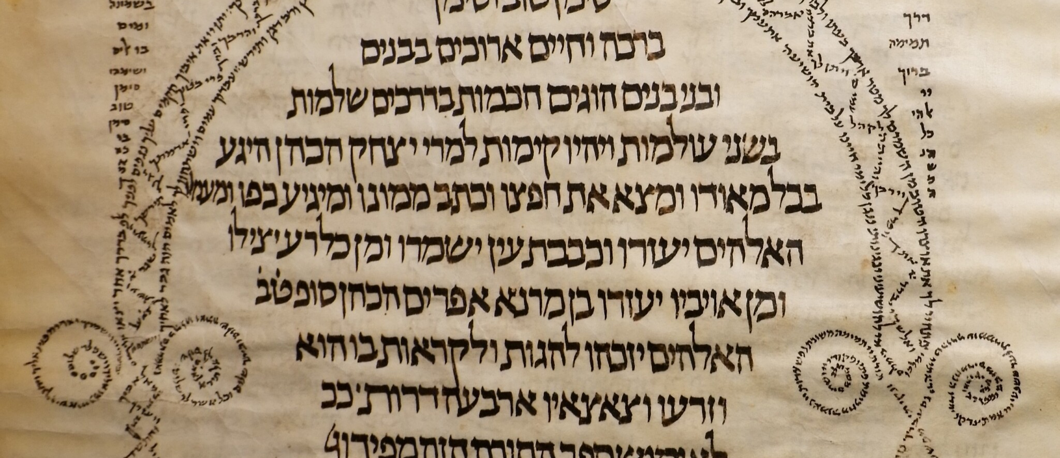
Original text One

Slide 8
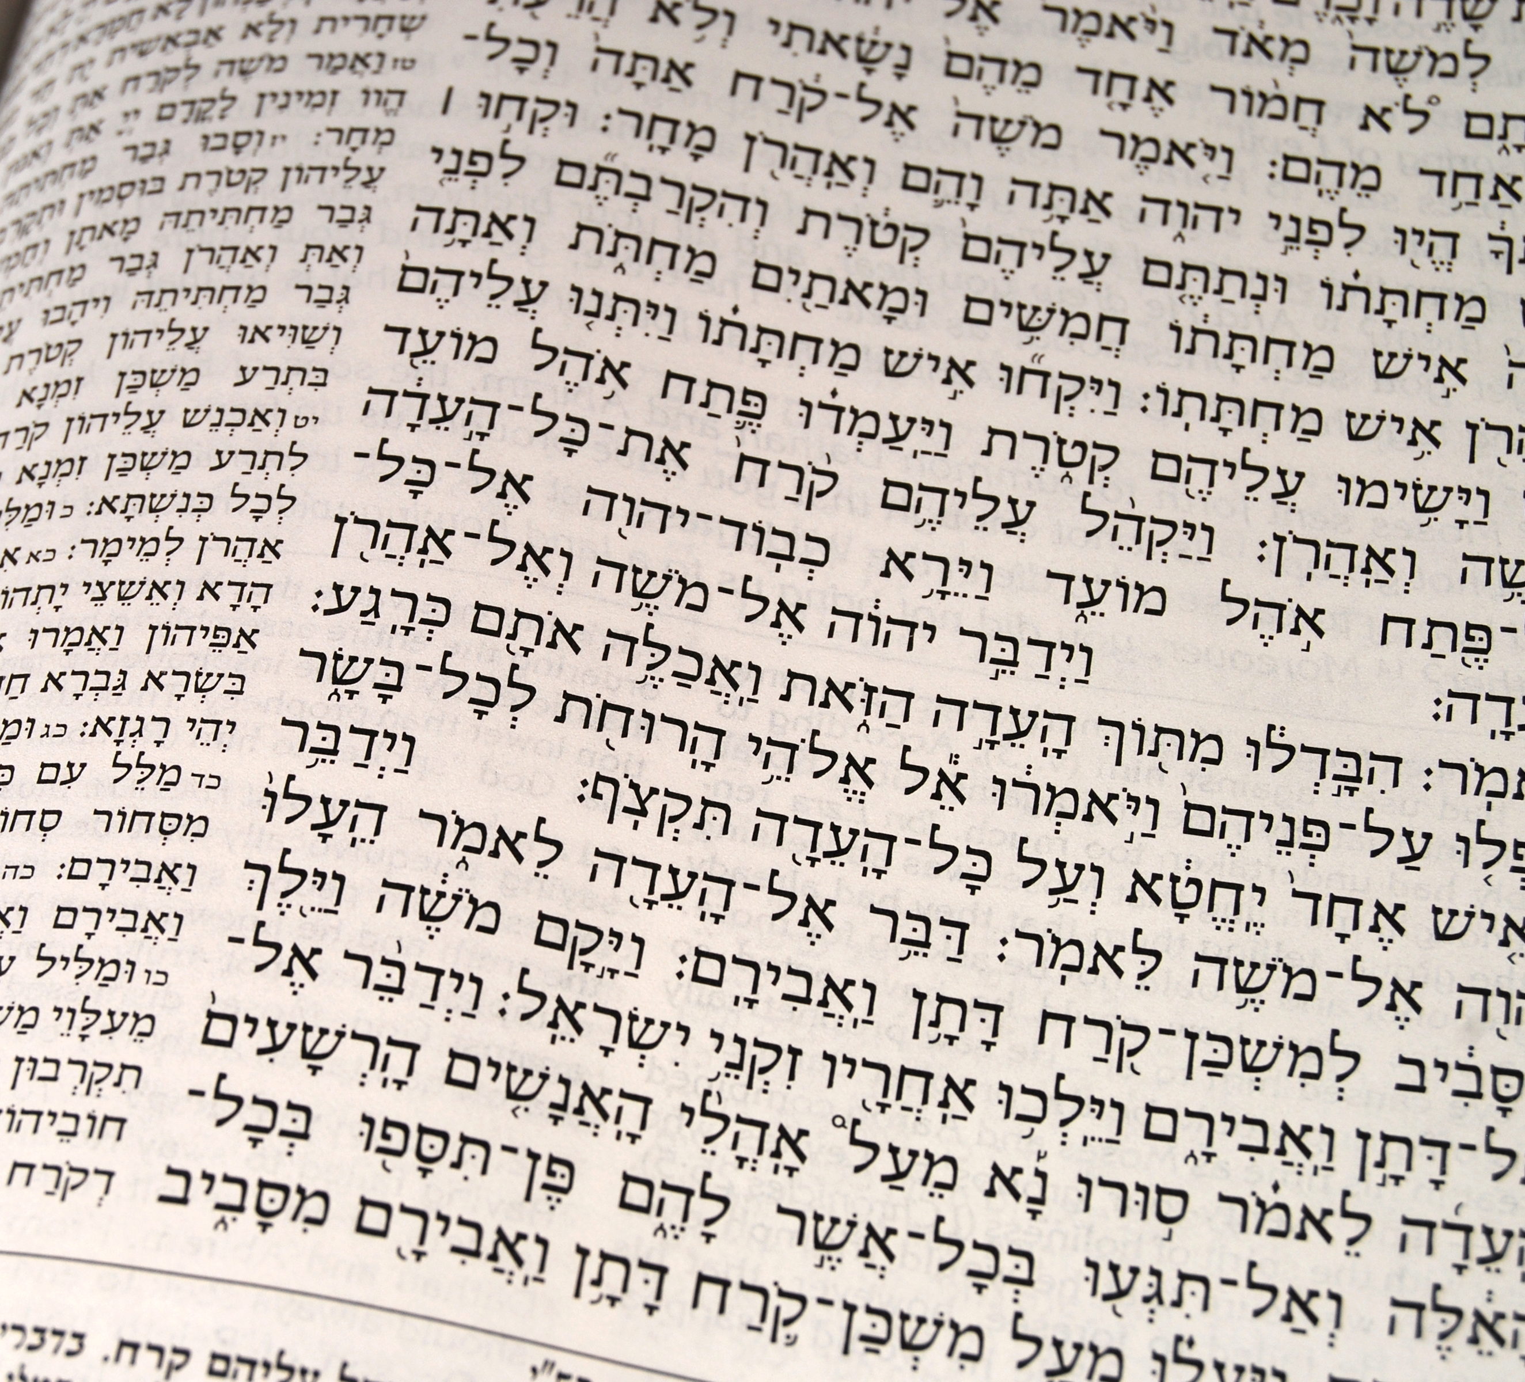
Original text Two

Slide 9
The reading of the la TORAH
The Jews did not pronounce the name of God (Exodus 20:7; Det 5:11)
YHWH was pronounced Adonai - ADONI (Sing)

Slide 10
The tetragram…
יהוה
YHWH
Traditional Hebrew has no vowels
There was no vowel until the 9th century after Jesus
The MASORETES decided to add the vowels

Slide 11
The tetragram
YHWH was pronounced Adonai - ADONI (Sing)
YAHWEH
Adonai means Lord equivalent in Greek is Curios

Slide 12
Where does the name Jehovah come from?
They took the vowels of Adonai and added in the tetragram
Result in Jehovah

Slide 13
Questions against the Jehovah's Witnesses
They think they are being persecuted because of Jehovah's name
Jesus promised that Christians will be persecuted because of his name: Mat24:9; Jn15:21
Are we saved by Jehovah's name or Jesus'? Acts 4:12
The early church never asked to pray to Jehovah's name

Slide 14
The name of God…
Acts
Characters
Identity
Ge 17:5 Abraham
Ge 32:28 Jacob

Slide 15
The Names of Gods…
El- shaddai (Ge 17:1)Exodus 6:4
Yahweh-Jireh: The Lord will provide (Genesis 22:13-14)
Yahweh-Raah: The Lord my shepherd (Psalm 23:1)
Yahweh-Rapha: The Lord who heals(Exodus 15:26)
Yahweh-Shamma: The Lord is here(Ezekiel 48:35)
Yahweh-Sabaoth: The Lord of hosts(Isaiah 1:24)
Yahweh-Nissi: The Lord my banner(Exodus 17:15)

